Slide 1


Green Pace
Security Policy Presentation
Developer: Daniel Lucia

Slide 2

OVERVIEW: DEFENSE IN DEPTH
The purpose of this security policy is to ensure that every level of an organization is secure. This policy adopts the Defense in Depth (DID) approach, which involves implementing multiple defense strategies to reduce the risk of an attacker gaining access to any vulnerability. If an attacker manages to breach one layer of security, there will be another layer in place to prevent them from proceeding further. This method helps to minimize the consequences of a security breach.

Slide 3
THREATS MATRIX
Secure coding standards have varying levels of vulnerability, which can impact the effectiveness of the standard. To help prioritize these levels, refer to the following chart.
Likely This level refers to threats that are most likely to happen. STD-INT32-C STD-MSC52-CPP STD-STR02-C STD-STR50-CPP STD-MEM52-CPP STD-ERR51-CPP STD-CTR51-CPP | Priority This level refers to standard threats that have high relevancy. STD-STR50-CPP STD-STR02-C STD-MEM52-CPP STD-INT32-C STD-MSC52-CPP
Low priority This level refers to standard threats that have low relevancy. STD-DCL55-CPP STD-ERR51-CPP STD-FIO50-CPP STD-DCL52-CPP STD-CTR51-CPP | Unlikely This level refers to threats that are less likely to happen. STD-DCL55-CPP STD-FIO50-CPP STD-DCL52-CPP

Slide 4
10 PRINCIPLES
Validate Input Data
STD-INT32-C
STD-STR50-CPP
STD-MEM52-CPP
STD-FIO56-CPP
STD-DLC52-CPP
STD-CTR51-CPP
Heed Compiler Warnings
STD-INT32-C
STD-STR50-CPP
Architect and Design for Security Policies
STD-MSC52-CPP
STD-MEM52-CPP
STD-ERR51-CPP
Keep It Simple
STD-DLC52-CPP
Default Deny
STD-STR02-C
Adhere to the Principle of Least Privilege
Sanitize Data Sent to Other Systems
STD-STR02-C
STD-DCL55-CPP
Practice Defense in Depth
Use Effective Quality Assurance Techniques
STD-INT32-C
STD-STR50-CPP
Adopt a Secure Coding Standard
STD-MSC52-CPP
STD-CTR51-CPP

Slide 5
CODING STANDARDS
Data Type (STD-INT32-C) – Ensure that operations on signed integers do not result in overflow
Data Value (STD-MSC52-CPP) – Value returning functions must return a value from all exit paths
String Correctness (STD-STR50-CPP) – Guarantee that storage for strings has sufficient space for character data and the null terminator
SQL Injection (STD-STR02-C) – Sanitize data passed to complex subsystems
Memory protection (STD-MEM52-CPP) – Detect and handle memory allocation errors
Assertions (STD-DCL55-CPP) – Avoid information leakage when passing a class object across a trust boundary
Exceptions (STD-ERR51-CPP) – Handle all exceptions
Object Oriented Programming (STD-FIO50-CPP) – Gracefully handle self-copy assignment
Signals (STD-DLC52-CPP) – Avoids using signals to show normal functionality
Error Handling (STD-CTR51-CPP) – Choose an appropriate termination strategy

Slide 6
ENCRYPTION POLICIES
Encryption in rest - Data encryption at rest refers to the process of encrypting the data while it is being stored. This ensures that unauthorized users cannot access the data without the key to decode it. Encryption converts the data into another form through an algorithm that can only be decrypted by authorized personnel. This policy is in place to protect the data in the system from falling into the wrong hands.
Encryption in Flight - Encryption at flight refers to the process of encrypting data while it is being transmitted over a network. This helps prevent unauthorized access to the data during transmission. The process involves the use of encryption keys, which are shared between the sender and the receiver of the data. The keys are used to decrypt the data at the receiving end, provided that the sender and receiver are authorized to access the data. This policy is important as it helps prevent theft of transmitted data.
Encryption in Use - Encryption in use takes a new approach that ensures that sensitive data is never left unsecured, regardless of or lifecycle stage (at rest, in transit, or in use) source, or location (on premise, cloud, or hybrid). These capabilities set in motion new opportunities for using, sharing, and monetizing data, securely and with confidence.

Slide 7
TRIPLE-A POLICIES
Authentication - Authentication is a crucial process that allows a business to monitor and give permission to certain individuals to access their system. This process involves creating unique usernames, passwords, or even signatures to ensure that only authorized users can access the system. Implementing authentication is essential as it prevents unauthorized users from gaining access to the system, which can lead to data breaches and exploitation of sensitive data.
Authorization - After authentication, the next policy is authorization to verify if the authenticated users have access to the data they are trying to access. Allowing too many users to access data that only certain users with clearance should access can lead to a security breach.
Accounting - Accounting refers to the process of monitoring and keeping track of a user's activities within a computer system. This involves tracking which databases were accessed, what actions were performed during the access, and which user initiated the system access.

Slide 8
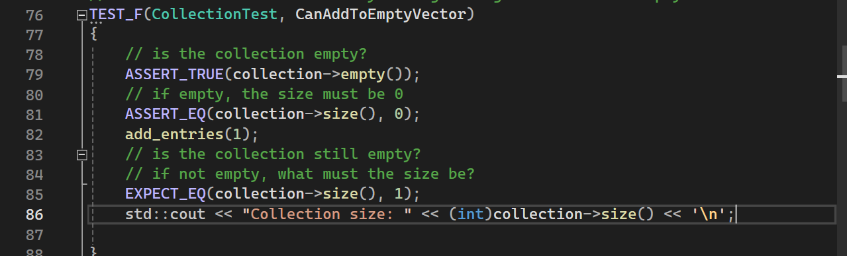
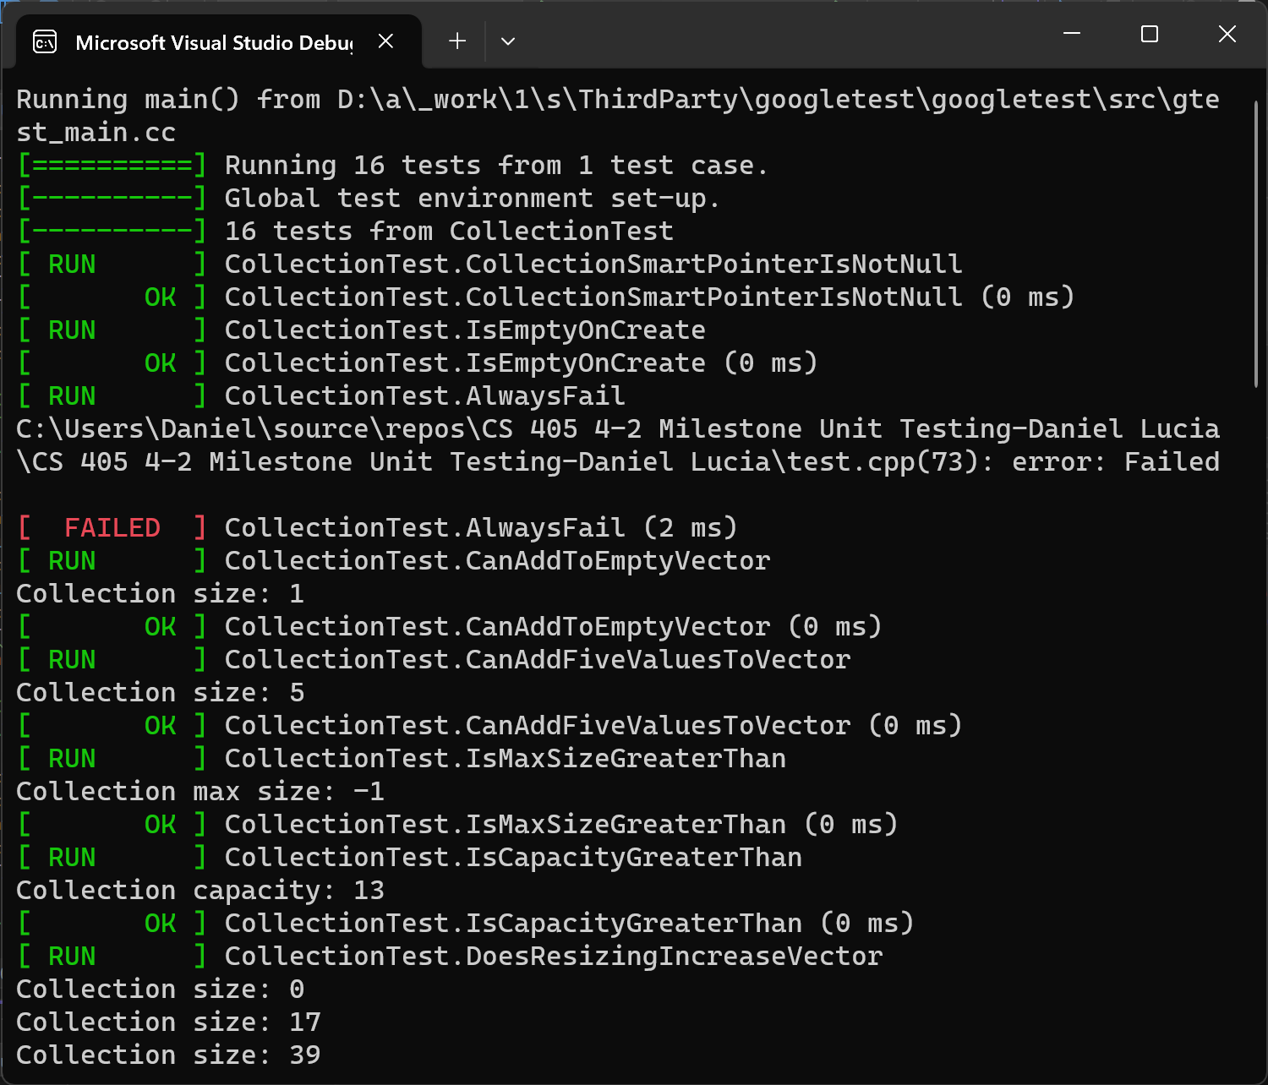
Unit Testing
CanAddToEmptyVector
This unit test checks to ensure functionality of adding a single value to an
empty collection. This is a positive test.
Unit Test Code
Result

Slide 9
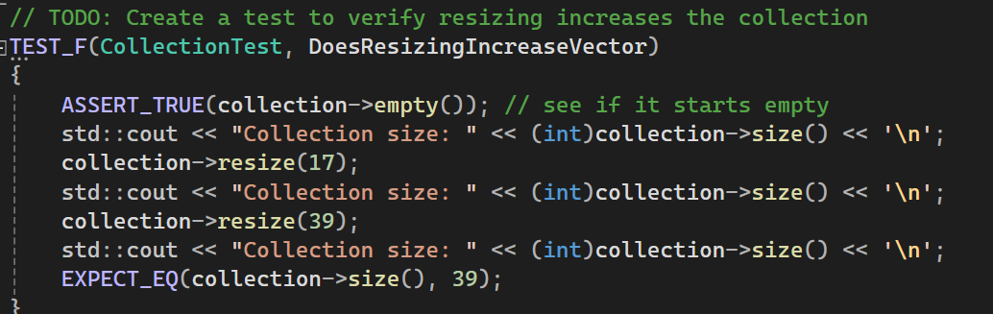
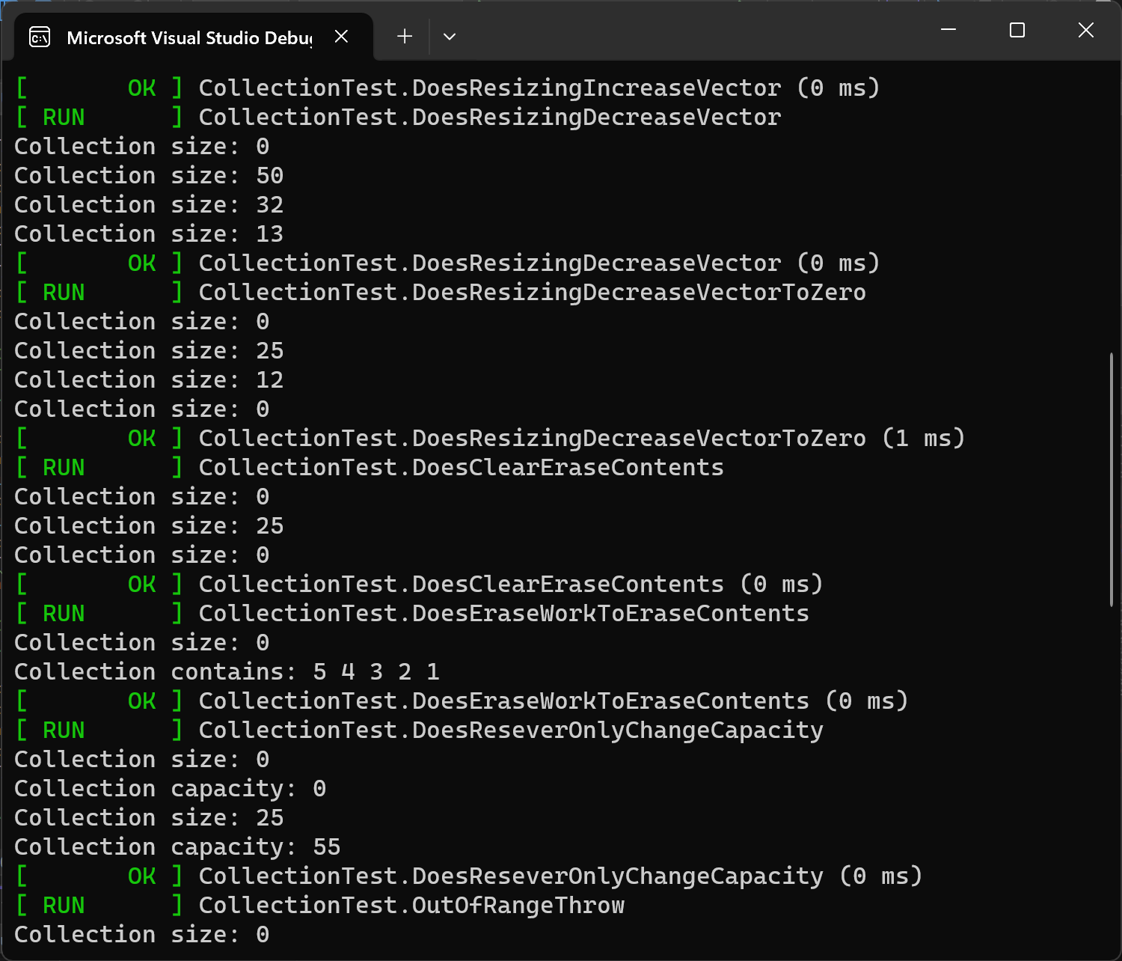
Unit Testing
DoesResizingIncreaseVector
This unit test checks that resizing the vector can increase the collection. This is a positive test.
Unit Test Code
Result

Slide 10
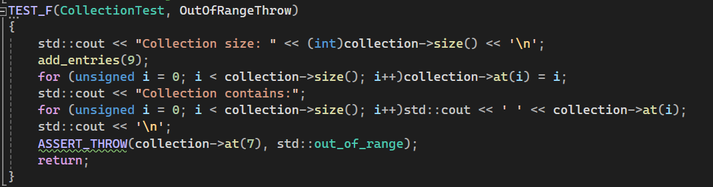
Unit Testing
OutOfRangeThrow
This unit test checks that the std:out_of_range exception is thrown when calling at() with an index out of bounds. This is a negative test.
Unit Test Code
Result

Slide 11

AUTOMATION SUMMARY

Slide 12
TOOLS
The DevSecOps pipeline is a strategy used by Green Pace to implement DID and secure methods. This strategy begins with a pre-production phase consisting of planning, designing, building secure code, and verifying and testing the system. Then, the production phase consists of maintaining the program, responding to any threats, monitoring and detecting threats, and transitioning and performing health checks.
Lightweight Directory Access Protocol (LDAP) can be used to query user information rapidly. LDAP controls the access and maintenance of static data, such as usernames, passwords, email addresses, and other sensitive.
Active directory (AD) is used to store sensitive information and is a secure way to control access to network resources.

Slide 13
RISKS AND BENEFITS
The risk of waiting to implement security policies is much greater than the risk if you begin implementing policies early on. By waiting, you risk time, money, and reputation if the program is completed and has many vulnerabilities. It would be detrimental to complete an entire program and begin all over with or expose your client’s secure data and risk your company’s reputation.
The solution to this is to begin implementing security from the very start. By doing this, there is a much higher level of security throughout the program, and there is a much lower risk of vulnerability.

Slide 14
RECOMMENDATIONS
Always communicate effectively with fellow developers.
Avoid adding any “backdoors” in the system.
Have a plan for when a breach does occur.
Stay consistent with coding standards.
Automate any routine tasks.

Slide 15
CONCLUSIONS
In conclusion, With the principles and standards mentioned within this presentation, we can conclude that most of all the important topics were covered to display our plan to create and maintain secure and proficient programming. We also have to adopt a zero-trust policy when accessing things inside and outside the company network to maintain security and privacy and keep all sensitive information safe and secure for all parties involved.

Slide 16
REFERENCES
Schiela, Robert. (Sep 08, 2023). Confluence. Retrieved from SEI External Wiki Home: https://wiki.sei.cmu.edu/confluence/

